Slide 1
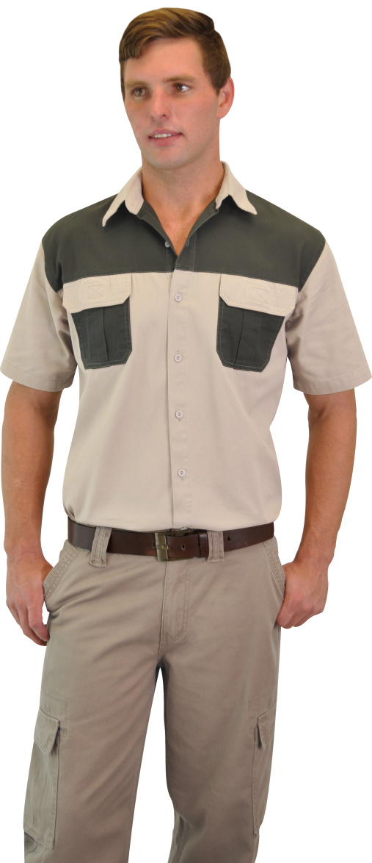
GAME RESERVE UNIFORMS

